Slide 1
AstroSage Call Center Performance Analysis Executive Data Analysis Dashboard Data Analysis Project using Microsoft Excel
Prepared By: Chandni Kalchuri
Project Objective:
Optimize operational efficiency, improve customer satisfaction, and maximize profitability using historical call center data.
Tools Used:
Microsoft Excel | Pivot Tables | Dashboard | KPI Analysis | What-If Analysis
1

Slide 2
• Problem Statement • Dataset Overview • Data Cleaning & Preparation • KPI Analysis • Executive Dashboard Overview • Operational Analysis • Customer & Revenue Insights • Strategic Recommendations • Investment Allocation • Conclusion
Agenda:
2

Slide 3
Problem Statement
Business Goal:
AstroSage received a ₹1 Crore investment and management wants to know where the investment should be allocated to maximize profitability, customer satisfaction, and operational efficiency.
The objective is to improve:
• Operational Efficiency
• Customer Satisfaction
• Revenue Growth
• Workforce Performance
Historical call center data was analyzed to support data-driven business decisions.
3

Slide 4
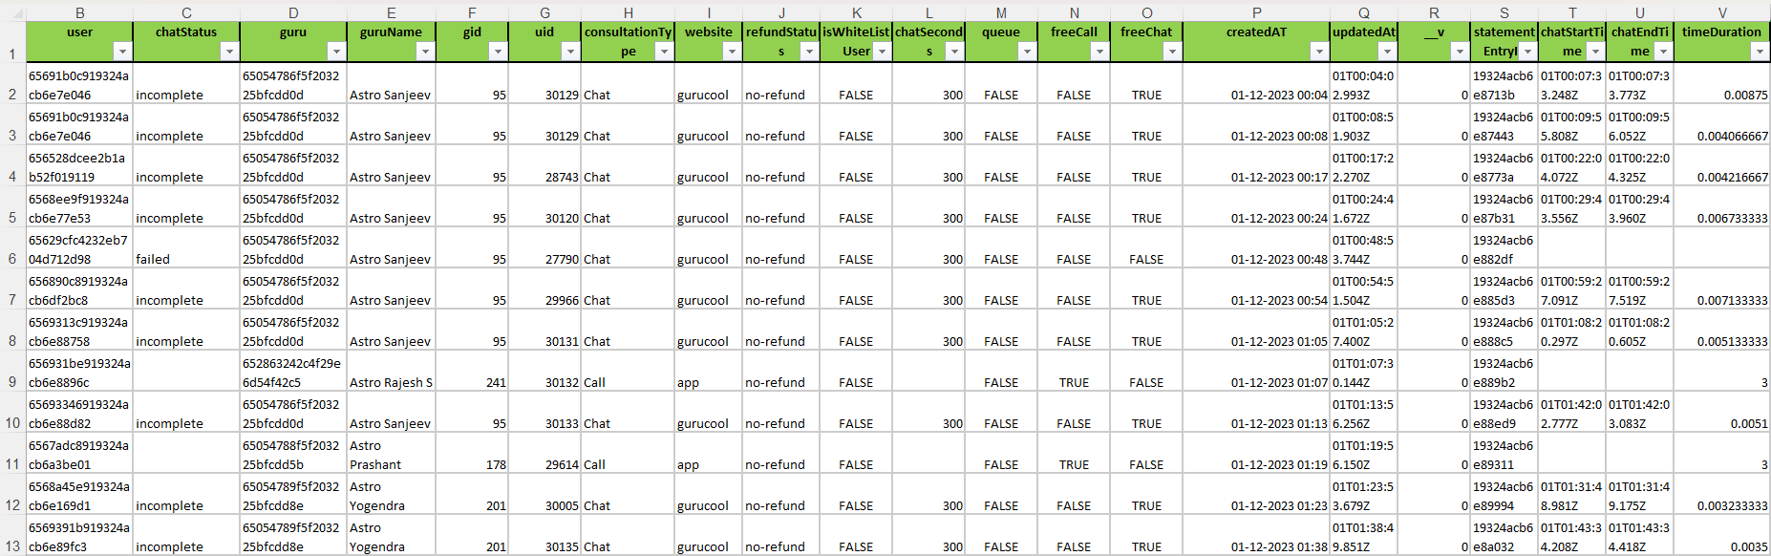
Dataset Overview
To answer the business problem, 28,027 customer interactions across 35 attributes were analyzed.
Dataset includes customer, guru, revenue, call behavior, ratings, and operational metrics.
Data types include:
- Numerical Variables
- Categorical Variables
- Date & Time Variables
Each row represents one customer interaction.
Figure 1: Raw Dataset Structure and Attributes Overview
4

Slide 5
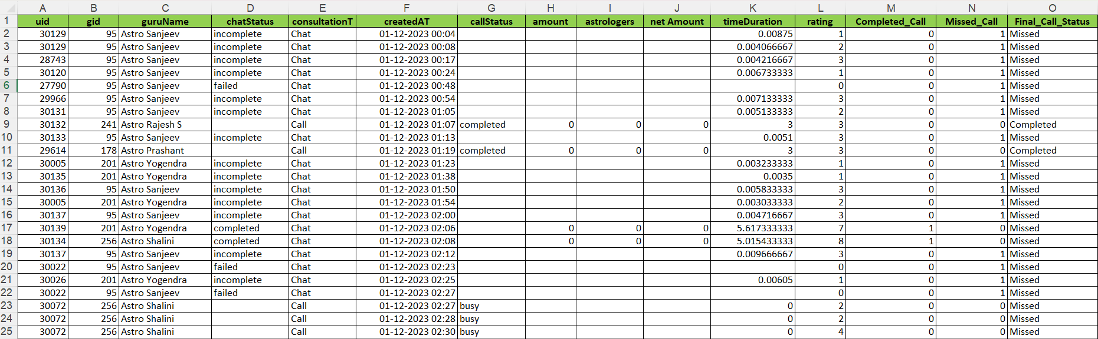
The raw dataset contained missing values and inconsistencies that could affect business decisions. Cleaning steps performed: • Removed missing/incomplete records • Standardized date formats • Checked duplicates • Corrected inconsistent categories • Created additional fields such as Month and Year • Prepared cleaned dataset for analysis
Data Cleaning & Preparation
Figure 2: Cleaned Dataset After Data Preprocessing
5

Slide 6
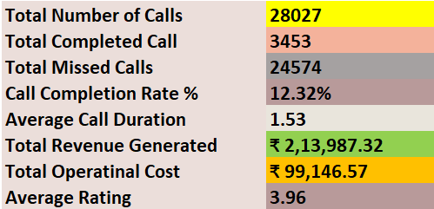
The KPI analysis provides a snapshot of current call center performance and operational efficiency. Key metrics monitored: • Total Calls • Completed Calls • Missed Calls • Completion Rate • Revenue Generated • Operational Cost • Average Rating • Average Call Duration
Key Performance Indicators (KPIs)
Figure 3: KPI Performance Overview
6

Slide 7
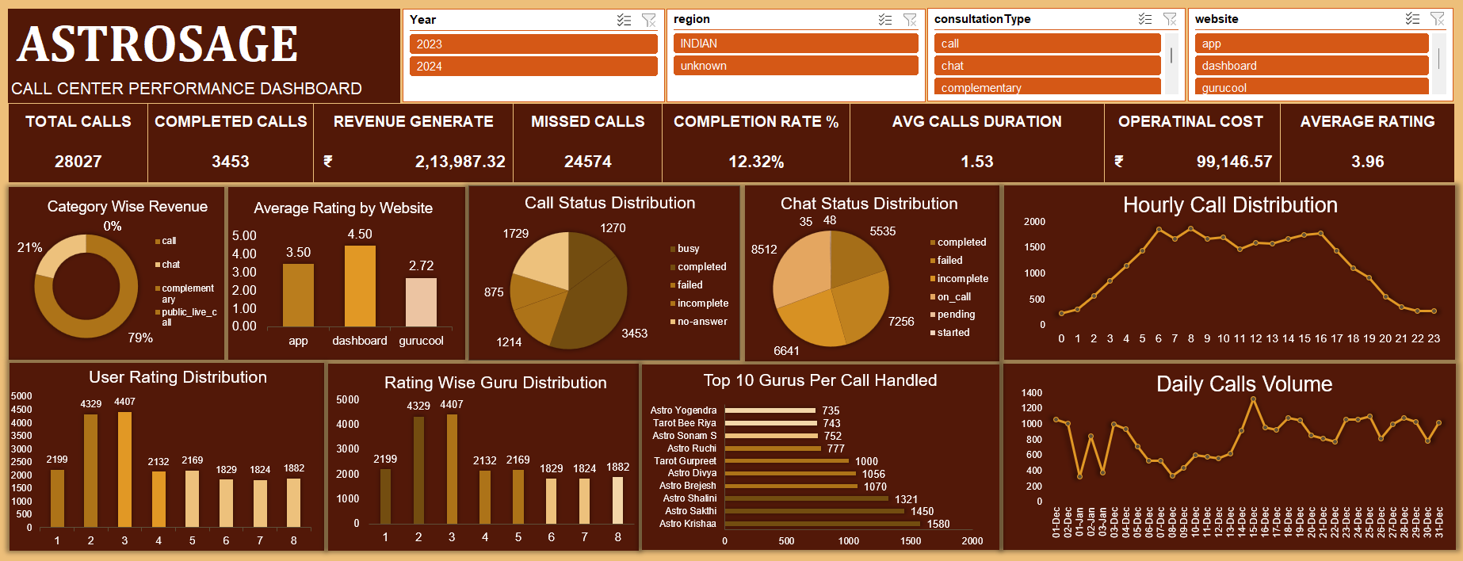
Executive Dashboard Overview
Figure 4: Interactive Executive Dashboard Overview
7
An interactive dashboard was developed to help management monitor performance and explore trends dynamically.

Slide 8
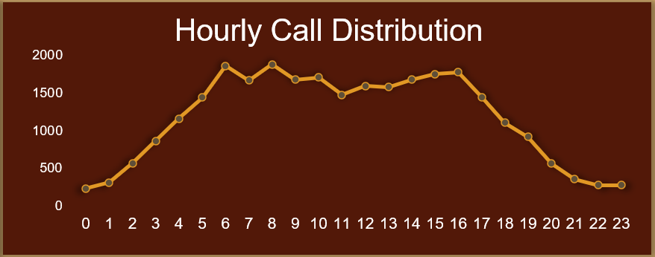
Hourly Call Distribution Analysis
The hourly distribution analysis was performed to identify peak demand periods.
Insight 1: Peak Demand Occurs During Specific Hours
Call volume increases gradually during daytime.
Peak activity occurs during evening hours.
Lower activity is observed during early morning periods.
These insights help optimize workforce scheduling.
Figure 5: Hourly Call Distribution Trend

Slide 9
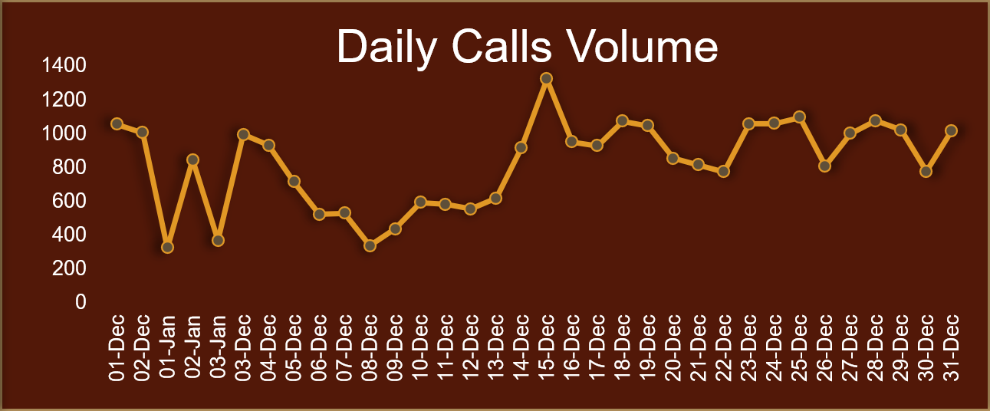
Daily Call Volume Trend Analysis
Daily call volume analysis was performed to understand fluctuations in customer demand.
Insight 2: Customer Demand Fluctuates Daily
Call volume changes significantly day by day.
Certain dates experience demand spikes.
Peak periods require additional staffing support.
Trend analysis supports workforce planning decisions.
Figure 6: Daily Call Volume Analysis

Slide 10
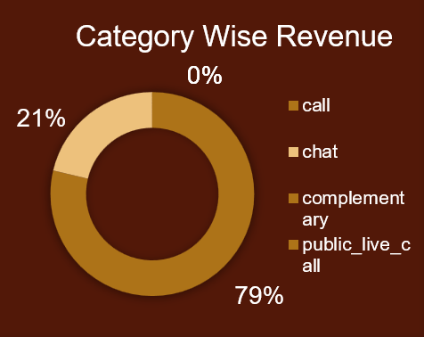
Revenue by Consultation Type
Insight 3: Revenue Is Concentrated in Call Consultations
Call consultations generate maximum revenue.
Chat consultations contribute moderate revenue.
Complimentary consultations contribute minimal revenue.
Revenue concentration helps prioritize business focus areas.
Figure 7: Revenue Distribution by Consultation Type

Slide 11
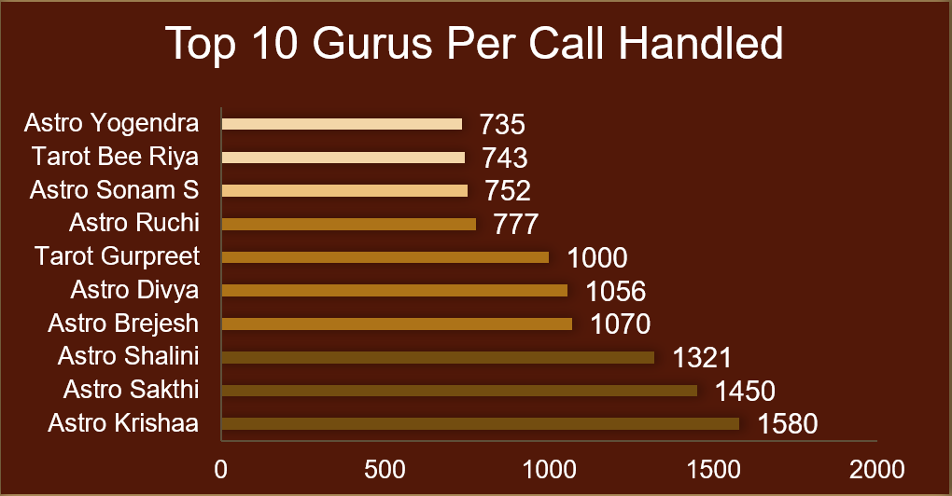
Top Performing Gurus by Call Volume
Insight 4: Workload Distribution Is Uneven
Certain gurus handle significantly more calls.
Workload distribution is uneven.
Top-performing gurus attract higher customer engagement.
High-performing agents can be used for benchmarking.
Figure 8: Guru-wise Call Handling Performance

Slide 12
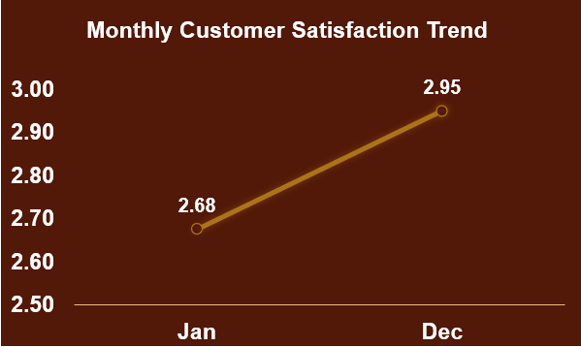
Customer Satisfaction Analysis
Insight 5: Customer Satisfaction Remains Strong
Average customer rating is 3.96.
Most ratings fall within mid-to-high satisfaction levels.
Satisfaction varies across different gurus.
Higher ratings indicate strong customer retention potential.
Figure 9: Customer Rating Distribution Analysis

Slide 13
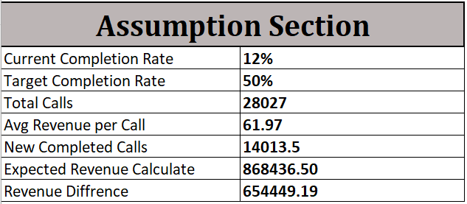
What Happens If Completion Rate Improves? – Call Completion Improvement
To estimate future business impact, a scenario analysis was performed by increasing completion rate from 12.32% to 20%.
Scenario Assumption:
Completion rate improves to 20%
Expected Outcomes:
Increase in completed calls
Revenue growth
Better operational efficiency
Reduced missed calls
Figure 10: What-If Scenario Analysis for Improving Call Completion Rate

Slide 14
Final Investment Allocation Strategy
Total Budget: ₹1 Crore
• ₹40 Lakhs → Hiring Additional Agents
• ₹25 Lakhs → Training Programs
• ₹25 Lakhs → Technology Upgrades
• ₹10 Lakhs → Monitoring & Analytics
Reason:
High missed calls and workload imbalance indicate the need for workforce expansion and operational improvements.

Slide 15
Final Interactive Dashboard
The final dashboard enables management to monitor KPIs and make data-driven decisions through interactive slicers.
Figure 11: Final Interactive Dashboard with Dynamic Slicers

Slide 16


Conclusion
Expected Business Impact:
✓ Reduced missed calls
✓ Higher customer satisfaction
✓ Improved operational efficiency
✓ Increased profitability
Business Recommendations
Hire additional agents to reduce missed calls.
Improve training programs to enhance service quality.
Upgrade technology to manage peak-hour demand.
Monitor KPI performance through the dashboard.
Focus on repeat customers to improve profitability.

Slide 17
Thank you
Thank You
Questions & Discussion
AstroSage Call Center Performance Analysis
Prepared by: Chandni Kalchuri
17

